Slide 1

INSTITUTE : UIE
DEPARTMENT : CSE
Bachelor of Engineering (Computer Science & Engineering)
Mobile Application Development(20CST-355)
TOPIC OF PRESENTATION:
Choosing a Mobile Web Option, Adaptive Mobile Websites
Prepared by:
Parveen Kumar Saini(E13339)
DISCOVER . LEARN . EMPOWER

Slide 2
Choosing a Mobile Web Option, Adaptive Mobile Websites

Slide 3
Web Developer or Android Developer – Which One is Better Career Choice?
Web development and Android development are the two most emerging career sectors for developers.
Both of these sectors require different skills, have different markets, and most important have diversified usability.
While making choice, we need to compare them on the basis of the frameworks required for development steps in learning Web Development and Android development, level of difficulty, career opportunities, salaries, and future trends of android and web development.

Slide 4
1. Understand Difference Between Web Development and Android Development:
Web Development involves coding, designing, and operating web applications and websites.
A proficient Web Developer is expected to design and develop a user-friendly website with easy navigation.
The programming languages needed for web development are HTML, CSS, JavaScript, etc. Web development can further be divided into 3 categories:
Front-End Web Development.
Back-End Web Development.
Full Stack Web Development.

Slide 5
Web development can further be divided into 3 categories:
Front-End Web Development: It involves designing the webpage i.e. how the website looks, inserting the content as well as specifying different navigation.
Back-End Web Development: It involves dealing with the database and server-side programming. It basically maintains all the data that is being entered and processes the data to display the output to the users.
Full Stack Web Development: It is a combination of front end development as well as back end development.
The full stack developer takes care of the designing of the websites as well as maintaining and processing the data entered.
Android Development involving the designing of mobile applications.
Here the developer is required to build the applications for android devices. In general, the most popular languages used for android development are Java and Kotlin.

Slide 6
2. Steps to Learn: Web Development and Android Development
Web Development:
Step 1: Select your field of interest among Front End and Backend Development
Step 2: Front End Developers need to learn the skills required such as
Creating the layout using HTML (Hypertext Markup Language)
Styling your web page using different attributes in CSS (Cascading Style Sheet)
How JavaScript fetches queries and responds to them and helps in adding interactive features such as audio, video, and images.

Slide 7
Web Development:
Step 2: Front End Developers need to learn the skills required such as
Responsive designs that help web pages to adjust to the device (Bootstrap)
Version control systems such as Git and GitHub also need to be used as they allow to track changes made and go back to the previous versions.
If you are interested in Backend development then you can learn
Programming languages such as Java or Python,
Server-side frameworks such as Node JS and
SQL and NoSQL Database Systems such as MYSQL, MongoDB where data to be stored, retrieved, and updated.
Step 3: You also need to know about HTTP protocols and deployment tools which allow moving files/data to and from the server.
Learning DevOps would be a great addition as it helps a single team to implement the entire Application Development Lifecycle.

Slide 8
Android Development:
An android developer specializes in designing applications and android apps for the marketplace.
Step 1: Learn the basics of android development which includes
Java SDK
Knowledge of any programming language among Java/Kotlin
Android UI Design
Step 2: Learn the advanced skills of android development which includes
Proficient in using Git, REST API
Knowledge about Database Systems
Able to design applications around UI, cloud message API, and continuous integration.

Slide 9
3. Difficulty Level
Front-End Web development is slightly easier than Backend Web development because in the backend you need to keep track of the data processed in addition to storing and maintaining the data.
Overall web development is comparatively easier than android development – however, it majorly depends on the project you build.
For example, developing a web page using HTML and CSS can be considered an easier job in comparison with building a basic android application.

Slide 10
4. Career Opportunities
The global mobile application development market is likely to expand at a 14% CAGR during the forecast period (2016-2022).
Similarly, the job opportunities for Web Developers are expected to grow by 25-27% by the year 2024.
So, the job market for both technologies is constantly increasing.
But since learning web development is comparatively easier than android development, competition for web developers is huge!
On the other hand, android developers are relatively lesser in numbers than web developers, so they are slightly in greater demand.
Developers skilled in both android and web development would have the highest demand overall because it will open up much more career opportunities for them in both the developing fields.

Slide 11
5. Learning Curve
Web development and Android development both offer great and impressive learning skills.
Web development gives us knowledge of different languages such as HTML, CSS, JavaScript, and also frameworks such as ReactJS, AngularJS, and server-side frameworks like NodeJS.
In mobile app development, you can learn about developing an iOS app as well as developing an android app.
Here, you get a chance to learn and implement programming languages like Java, Kotlin, etc.
Learning Git and GitHub and database management systems is a common requirement for any kind of software development process.

Slide 12
6. Salary & Future Advancements
Salary is one of the most seen requirements while deciding on career options.
So for a Web developer in India, salary varies from 5 LPA to 27 LPA depending upon the experience and expertise in the development.
Salary of android developer also lies somewhere in the same region, it is slightly more for iOS developers as skilled iOS developers are lesser as compared to android developers.
As technological advancements are growing day by day, web developers and android developers both have a great future ahead.
The demand for good and user-friendly mobile and web applications is continuously going to rise in the future and not going to stop any time soon!!
So, as of now, you have got a clear picture of which career option suits you the best! Now, what are you waiting for? Pick up a domain and start learning!!

Slide 13
What is the dif­fer­ence be­tween a mo­bile app and a web app?
As a busi­ness owner, pro­ject man­ager or stake­holder, one of the crit­i­cal de­ci­sions you will make in your quest for cus­tom soft­ware will be whether to de­velop a mo­bile ap­pli­ca­tion or a web ap­pli­ca­tion.
Unless you are fa­mil­iar with the ba­sics of web­site de­vel­op­ment, there is a high chance you need a suit­able an­swer to this ques­tion: how do desk­top apps, web apps and mo­bile apps dif­fer?
This is not to say that you can’t dif­fer­en­ti­ate be­tween a mo­bile ap­pli­ca­tion and a web ap­pli­ca­tion on your own, but do you know which of the two of­fers a higher re­turn on in­vest­ment?
What are the fac­tors that you need to con­sider be­fore you de­cide? Which of your buyer per­sonas mo­ti­vated your choice?

Slide 14
We ex­plore the dif­fer­ences be­tween web apps and mo­bile apps.
have knowl­edge of the processes in­volved in build­ing mo­bile and web apps,
have knowl­edge of the tech­nol­ogy be­hind it,
know how to de­cide which of them is suit­able for your busi­ness and how you can link your web­site to whichever kind of ap­pli­ca­tion you choose,
understand the var­i­ous fac­tors to con­sider be­fore you choose one,
and lastly, know how you can lever­age web and mo­bile app de­vel­op­ment to achieve your busi­ness goals.

Slide 15
Mobile App vs. Web App: Deﬁnitions, Pros and Cons
The traf­ﬁc com­ing from mo­bile apps and web apps make up a con­sid­er­able vol­ume of all or­ganic traf­ﬁc for web­sites and eCom­merce stores.
Mobile app vs web app sta­tis­tics are stag­ger­ing.
Currently, mo­bile apps are re­spon­si­ble for 50% of web traf­ﬁc glob­ally for the last four con­sec­u­tive years (2017 — 2021).
However, traf­ﬁc is not the sole in­di­ca­tor of busi­ness re­turn.
You still need to con­sider your Click-Through Rate (CTR), sales con­ver­sion, and cus­tomer re­ten­tion.
So, let’s brieﬂy de­ﬁne and com­pare the pros and cons of build­ing mo­bile apps and web apps.

Slide 16
What are web apps?
Web ap­pli­ca­tions, short­ened as web apps, are ap­pli­ca­tion pro­grams stored re­motely on a server and de­liv­ered to a web browser in­ter­face via the in­ter­net.
Think about the func­tion­al­ity you can per­form on your browser.
These in­clude on­line cal­cu­la­tors, word pro­cess­ing, eCom­merce stores, in­ter­net bank­ing, stock trad­ing, etc.
Some web apps only work with spe­ciﬁc browsers, while oth­ers work re­gard­less of the browser.

Slide 17
What are mo­bile apps?
Mobile ap­pli­ca­tions, also known as na­tive apps, are de­signed to func­tion ex­clu­sively on mo­bile de­vices.
Mobile apps have ac­cess to many fea­tures of mo­bile de­vices, such as the mi­cro­phone and cam­era, and there­fore of­fer im­proved func­tion­al­ity and op­ti­mal user ex­pe­ri­ence

Slide 18
Mobile App Vs Web App Pros
Here is a quick com­par­i­son be­tween mo­bile apps and web apps.
Mobile App
Higher speed and per­for­mance due to built-in fea­tures on phones such as lo­ca­tion ser­vices, cam­era and mi­cro­phone, etc.
Superior user ex­pe­ri­ence and optimized per­for­mance for over­all bet­ter functionality.
Push no­ti­ﬁ­ca­tions that en­hance con­ver­sion on the go for bet­ter engagement.
Ability to reach a broader au­di­ence by lever­ag­ing stores (App Store vs. Google Play).
Web App
Cost-efﬁcient in its de­vel­op­ment, re­sult­ing in a smaller amount of time and re­sources re­quired to build.
Easily ac­ces­si­ble to the mar­ket as it re­quires no ap­proval from mar­ket­places and app stores.
Wider cov­er­age to users re­gard­less of the type of de­vice or op­er­at­ing system.
Instant up­dates since it uses a com­mon code base al­low­ing for sim­pler and faster up­grades.

Slide 19
Mobile Apps vs Web Apps Cons
Here is a quick com­par­i­son of a mo­bile app vs web app cons
Mobile App
Requires high in­vest­ment as the cost of de­vel­op­ing across var­i­ous op­er­at­ing sys­tems can be ex­pen­sive.
For in­stance, Android apps can­not work on Apple prod­ucts and vice versa.
The need to down­load, in­stall and grant ac­cess can be a turn off for po­ten­tial cus­tomers and, as such re­sult in a loss of revenue.
High cost of main­te­nance due to con­stant plat­form hard­ware and soft­ware up­grades. E.g. new phones or op­er­at­ing systems.
Getting ap­proval from the app store can take time, and bad ex­pe­ri­ences/ rat­ings from users can kill the app and have se­vere neg­a­tive con­se­quences on the busi­ness.
Web App
Dependence on in­ter­net avail­abil­ity means the app is al­most use­less where there is no in­ter­net access.
Limited ac­cess to de­fault mo­bile de­vices fea­tures such as GPS, cam­era, mi­cro­phone, etc.
Non-uniform ex­pe­ri­ence for users as dif­fer­ent web browsers can af­fect the smooth run­ning of the web appMost browsers do not sup­port push no­ti­ﬁ­ca­tions, which trans­lates to po­ten­tial loss of en­gage­ment and cus­tomers.

Slide 20
Understanding the tech­nol­ogy be­hind de­vel­op­ment
Web de­vel­op­ment has a lot of tech­ni­cal jar­gon that many busi­ness lead­ers will ﬁnd bor­ing.
It re­ally sucks read­ing tech­ni­cal terms when you can’t wrap your head around them.
However, we’ll cover the ba­sics and sim­plify it for you as much as pos­si­ble.
Having the ba­sic knowl­edge be­hind the tech­nol­ogy we lever­age will give you an in­sight into which one is the most suit­able for your busi­ness.
Full-stack de­vel­op­ment is broadly di­vided into two main cat­e­gories; front-end and back-end.
The front-end deals with con­vert­ing data into a graph­i­cal in­ter­face with the use of pro­gram­ming lan­guages such as JavaScript (JS), Hypertext Markup Language (HTML), and Cascading Style Sheet (CSS).
Used by al­most all web de­vel­op­ers to code cus­tomer be­hav­iours into web­sites, web apps or mo­bile apps.

Slide 21
Understanding the tech­nol­ogy be­hind de­vel­op­ment
HTML: Hypertext Markup Language han­dles the struc­tur­ing of your web page.
CSS: The Cascading Style Sheet is a pro­gram­ming lan­guage that con­trols the pre­sen­ta­tion of your web page. It re­mains the foun­da­tion of the World Wide Web to­day, along­side JavaScript and HTML.
Back-end de­vel­op­ment in­volves utilizing data­bases to trans­fer and re­ceive data from one end to an­other.
It also en­com­passes the man­age­ment of user con­nec­tions, se­cure con­nec­tion and every­thing that em­pow­ers your web ap­pli­ca­tion to per­form op­ti­mally.
Popular pro­gram­ming lan­guages such as Python, Java, PHP and Ruby are used for back-end de­vel­op­ment.

Slide 22
Mobile web app frame­works and other tech­nolo­gies
Every busi­ness is unique, and so are the tech­nolo­gies that power their ap­pli­ca­tions.
Analyzed var­i­ous fac­tors that are im­por­tant to con­sider when choos­ing be­tween mo­bile apps and web apps.
However, the tech­nol­ogy de­ployed also de­pends on some fac­tors.

Slide 23
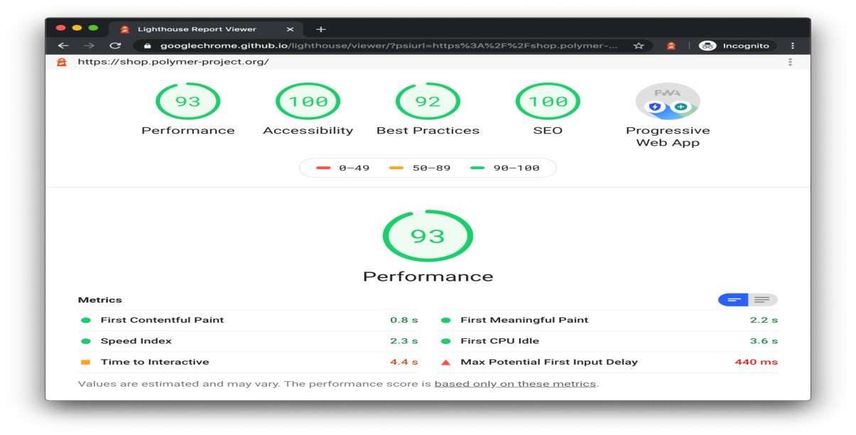
Some fac­tors.
Website
Speed of in­for­ma­tion mat­ters in web­site de­vel­op­ment.
Many web de­vel­op­ers of­ten pri­ori­tise vi­sual ap­peal over load­ing speed. According to sev­eral re­ports, 40% of users leave web­sites that take longer than 2 - 3 sec­onds to load.
The lighter and softer your web­site, the faster it shows data, and the higher Google will score it on Google Lighthouse.

Slide 24
Web App
When we say web app, we are re­fer­ring to re­spon­sive web apps.
For busi­nesses that want to save both money and time, we usu­ally rec­om­mend de­vel­op­ing re­spon­sive web apps ﬁrst be­fore build­ing mo­bile apps.
An ex­am­ple of this is when you have one app that works on a desk­top as well as through a mo­bile browser, such as Slack.
Slack.
Slack makes it easy to contact your colleagues – you can message anyone inside or outside your organization and collaborate just as you would in person.
People can work in dedicated spaces called channels, which bring the right people and information together.
What is the purpose of Slack?
Slack is a messaging app for business that connects people to the information they need. By bringing people together to work as one unified team, Slack transforms the way organizations communicate.

Slide 25
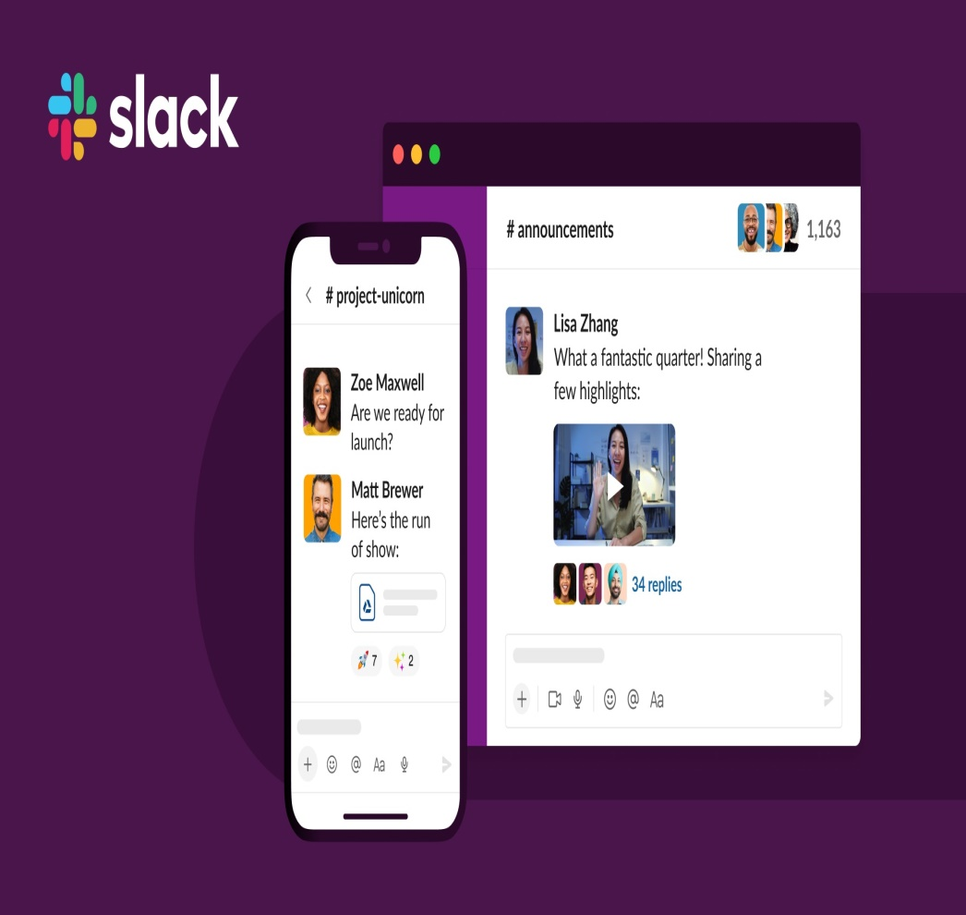
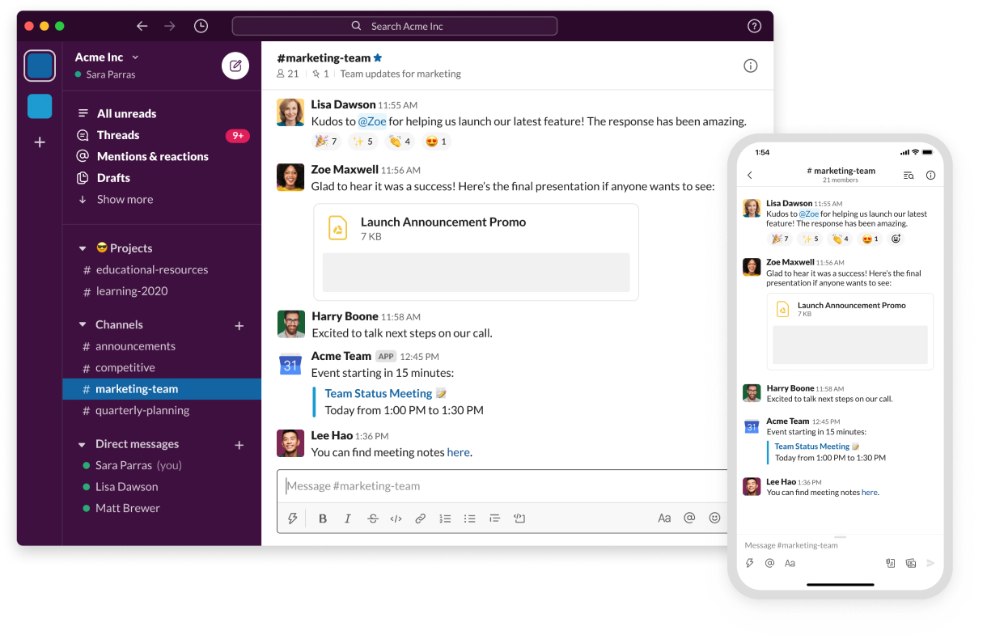
Slack.

Slide 26
Mobile App
There are many tech­nolo­gies mo­bile de­vel­op­ers de­ploy for app de­vel­op­ment.
However, we rec­om­mend us­ing React Native due to its re­spon­sive user in­ter­face and fast load time.
One ques­tion that most busi­ness own­ers ask is, can we in­te­grate mo­bile ap­pli­ca­tions to web ap­pli­ca­tions? The quick an­swer is, yes!
Mobile ap­pli­ca­tion in­te­gra­tion can be car­ried out us­ing ap­pli­ca­tion pro­gram­ming in­ter­face (API) tools and by us­ing a shared data­base.
So yes, mo­bile apps de­vel­oped with React Native can be linked to web apps. However, con­sider what the in­ten­tion of the prod­uct is.
If it is im­por­tant to be across all de­vices, note that you only need a mo­bile app and a min­i­mum vi­able prod­uct (MVP) to get started cre­at­ing the ap­pli­ca­tion ecosys­tem.
If the prod­uct re­quired na­tive de­vice ac­cess, such as ge­olo­ca­tion, that can’t be ac­cessed through a web app - that func­tion­al­ity would­n’t be avail­able across all plat­forms.

Slide 27
The process of build­ing a mo­bile app
According to Statista, mo­bile apps’ rev­enue through app stores and in-app ad­ver­tis­ing stands at $693 bil­lion, while en­ter­prise mo­bil­ity has a pro­jected value of $510.39 bil­lion by 2022.
As a busi­ness owner or stake­holder, your com­pany should take ad­van­tage of these grow­ing trends.
Beyond app cre­ation, the mo­bile app de­vel­op­ment processes your de­vel­op­ers adopt will de­ter­mine the suc­cess or oth­er­wise fail­ure of your app.
At WorkingMouse, we fol­low a de­vel­op­ment process we call the Way of Working that en­sures all your scope re­quire­ments are fully met.

Slide 28

The process of build­ing a mo­bile app

Slide 29
Web App Vs. Mobile App: Which is bet­ter for my busi­ness?
How would you feel if we told you that so­lu­tion A is bet­ter than so­lu­tion B?
You might take our word for it. Unfortunately, though, we can’t make that de­ci­sion for you.
No two busi­nesses are the same, ir­re­spec­tive of their level of sim­i­lar­i­ties.
Even if you be­long to the same in­dus­try and serve the same au­di­ence, your busi­ness strate­gies and cus­tomer ser­vice is ex­clu­sively your as­set.
As such, your de­ci­sion to opt for a web app or na­tive app de­pends on sev­eral fac­tors, which we’ve cov­ered off be­low:

Slide 30
Top 6 Factors to con­sider while choos­ing web app vs mo­bile app
Here are some of the fac­tors to con­sider in the web app vs. mo­bile app de­bate:
1. Target Audience
2. Functionality and user ex­pe­ri­ence (UX)
3. Development and launch time
4. Organic reach and ease of dis­cov­er­abil­ity
5. Privacy Concerns
6. Budget

Slide 31
1. Target Audience
Your cus­tomers are the most crit­i­cal de­ter­mi­nant of most of your busi­ness de­ci­sions.
You need to un­der­stand your buyer per­sonas, de­mo­graph­ics, psy­cho­me­t­ric, pur­chase power and pref­er­ences.
Comparing web apps and mo­bile apps sta­tis­ti­cally will al­ways favour the lat­ter.
This is be­cause, for every 1% in­crease in web app au­di­ence, there is a 41% in­crease in mo­bile users.
However, a di­rect com­par­i­son might not be log­i­cal busi­ness-wise.
You need to know which of the two your au­di­ence is more com­fort­able work­ing with.

Slide 32
1. Target Audience
For in­stance, if your busi­ness serves the mil­len­nial, choos­ing a web app over a mo­bile app spells dis­as­ter right from the start.
In con­trast, if your cus­tomers are busy pro­fes­sion­als such as bankers, ac­coun­tants, or busi­ness lead­ers, there is a chance that they will not have time to op­er­ate mo­bile de­vices as they are al­ways glued to their lap­tops.
In that case, a web app may be an in­tel­li­gent choice.
Also, if you need to up­date your ap­pli­ca­tion fre­quently, it will be best to in­vest in a web app over a na­tive app.
However, if your ser­vices re­quire cus­tomers to use your app of­ﬂine with full func­tion­al­ity, a mo­bile app is the pre­ferred choice.

Slide 33
2. Functionality and user ex­pe­ri­ence (UX)
As we ex­plained ear­lier, mo­bile apps al­low the user to use mo­bile de­vices with in­built func­tion­al­i­ties such as cam­era, mi­cro­phone, lo­ca­tion and so on.
Therefore, if the prod­ucts or ser­vices you mar­ket re­quire that your cus­tomers use these fea­tures, then you should con­sider na­tive app de­vel­op­ment.

Slide 34
3. Development and launch time
Time is al­ways a crit­i­cal fac­tor for the suc­cess of your busi­ness.
If you need to reach your cus­tomers within the short­est pos­si­ble time, a web app is def­i­nitely your best op­tion.
This is be­cause mo­bile app de­vel­op­ment is time-con­sum­ing from a tech­ni­cal per­spec­tive.
Additionally, you will need to de­velop dif­fer­ent apps for the var­i­ous op­er­at­ing sys­tems, Android and iOS.
Furthermore, the mar­ket­place re­quires ap­proval be­fore you can pub­lish it for users to down­load.

Slide 35
4. Organic reach and ease of dis­cov­er­abil­ity
Despite the num­ber of users, mo­bile apps rely en­tirely on busi­ness­es’ ef­forts in let­ting their cus­tomers know about their app.
Some users as­sume that every busi­ness owns a mo­bile app.
Thus, many of them will pos­si­bly check you out on the Play or App Store to see what they can ﬁnd. On the other hand, web apps are ranked or­gan­i­cally through web­site pages.
Therefore, your SEO ef­fort will ben­e­ﬁt web apps over mo­bile apps.
What does SEO means?
Search Engine Optimization
SEO means Search Engine Optimization and is the process used to optimize a website's technical configuration, content relevance and link popularity so its pages can become easily findable, more relevant and popular towards user search queries, and as a consequence, search engines rank them better.

Slide 36
5. Privacy Concerns
With cy­ber­crime grow­ing and the con­tin­u­ous aware­ness of the need for pri­vacy, many cus­tomers are con­scious of the apps they in­stall on their phones.
If users need to grant ac­cess to use some of your ap­pli­ca­tion fea­tures, they may be dis­cour­aged from in­stalling the app.
This gives web apps an edge over na­tive apps.

Slide 37
6. Budget
Web apps are more bud­get-friendly com­pared to mo­bile apps.
If your busi­ness seeks to minimize ex­penses, a web app is a more cost-friendly choice.
However, you need to be care­ful not to priorities bud­get over achiev­ing your busi­ness ob­jec­tives.

Slide 38
Advantages and Disadvantages of Adaptive Web Design
Adaptive web design is especially developed to adjust to size of browser or screen. In adaptive web designing, different website layouts are created to fit best to specific screen sizes of different devices.
Basically, two versions of websites are generally created, one is created for small screen i.e., mobile version and other one is created for large screen i.e., desktop version.
Mobile versions are used for smartphones, tablets, etc., and desktop versions are used for laptop, desktop.
Website or server detect size of device screen and then choose website layout that fit best on device screen.
Choosing right website design will lead to better performance and positive result because different business has different needs and requirements.
Therefore, before choosing any web design, determine what are your needs and web design can be beneficial or not.

Slide 39
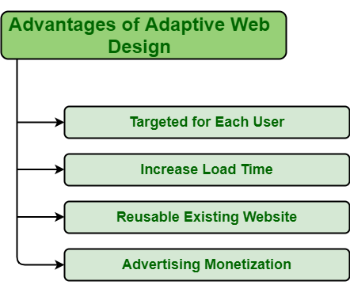
There are several advantages and disadvantages of adaptive web design that can help in making decision. Some of them are given below:

Slide 40
Several advantages of adaptive web design
Targeted for each user
Increase load time
Reusable existing websites
Advertising monetization

Slide 41
Several advantages of adaptive web design
Targeted for each user: Adaptive web design create different versions of website for different devices for increasing user experience at individual devices.
On each device, users should have a positive experience. In this web design, one can customize and change page content, layout to best fit screen and improve user experience.
Increase load time: Adaptive web design create different layout for different devices and display features that are best for specific website.
Whenever user load website on their device, then layout that fit best on device screen gets loaded.
This increase loading speed as traffic is decreased.
Even, server detect device size and then provide layout that will fit best on device screen.
It provides high resolution graphics only when it detects high-density screen.

Slide 42
Several advantages of adaptive web design
Reusable existing websites: Some of complex websites are developed using legacy code i.e., source code written using outdated technology or is no longer supported and is incomprehensible.
Adaptive websites have different versions of layout for different devices.
So, if one wants to change or update something, then they do not need to go back to drawing board and again re-code existing website from starting point.
Advertising monetization: Monetizing websites with ads will only lead to more money and give more opportunities for earning.
Adaptive website is the best way to optimize advertise options as adaptive websites are designed to fit best on device it is viewed on.
There is no need to chan5ge or replace ratio of banners, images, etc., for smaller resolutions to display best on screen because smaller versions of websites are available.
Ad monetization is the practice of taking the existing traffic you drive to your website or digital property and monetizing that traffic by presenting advertisements to those viewers in exchange for payment from advertisers.

Slide 43
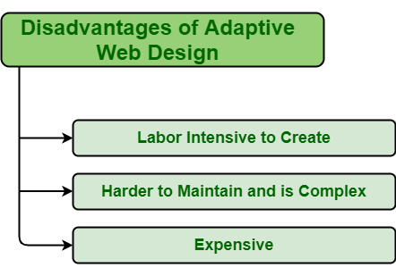
Several disadvantages of adaptive web design

Slide 44
Several disadvantages of adaptive web design
Labor intensive to create .
Harder to maintain and is complex.
Expensive.

Slide 45
Several disadvantages of adaptive web design
Labor intensive to create: Adaptive web design are not easy to create.
It requires great thinking skills and more labors to create.
Adaptive web design requires more time and effort as different website layouts are created to best fit on screen.
Different website layout means different html code, and more will be code, then more will be labors required to develop it.
Harder to maintain and is complex: Adaptive websites are not easy to maintain as it is not easy to maintain all website versions at same level.
One has to update and maintain each version of website individually whenever required.
Expensive: Adaptive web design is labor intensive I.e., requires a greater number of developers or labors to create it and also requires a lot of budgets to handle complexity.
Adaptive design is complex and complicated and therefore it is expensive. It is more expensive to build and maintain.

Slide 46
Difference between responsive design and adaptive design
In earlier times, web designers design the user interface of the website by considering the size of the desktop.
but nowadays we use websites for Mobile, Tablet, laptops, Wearable devices, and many more devices so the size of the screen differs for each device.
Considering these things in mind web designer wants to design a user interface in such a way that it works properly and fully functionally on all types of devices.
So Responsive Design and Adaptive Design come into play, Both provide a better user interface for all types of devices but both follow a different path.

Slide 47
Responsive Design:
In this design web designers design the user interface of a website in such a manner that whatever device you are using you can access comfortably web page.
if we use a web page on the laptop then it splits into a large view but if you use the same web page on mobile then it synchronizes itself.
web designers simply design it by using only HTML & CSS. designer works with the developer for a better user experience.

Slide 48
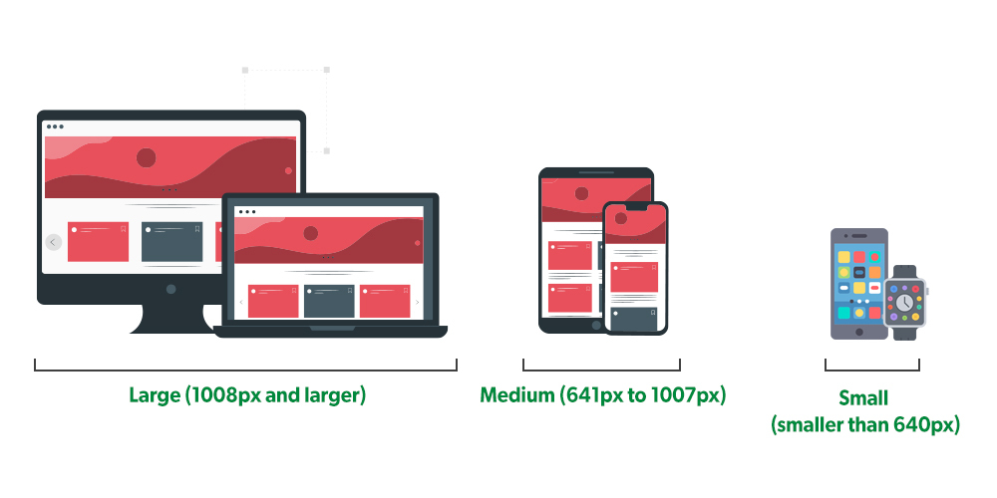
Responsive Design:

Slide 49
Adaptive Design:
In this design web designers design the user interface of a website in such a manner that it creates different layouts of the web page for the different devices.
so based on the screen size of the device it loads the layout of the page. it creates the different layouts for different devices like screen size as for 320px, 480px, 760px, 960px, 1200px, 1600px.
for different sizes of mobile screens, tablet screens, and many more devices it depicts the size of layouts of the screen and displays the content of the page. web designers have to work more because they have to develop six different pages.

Slide 50
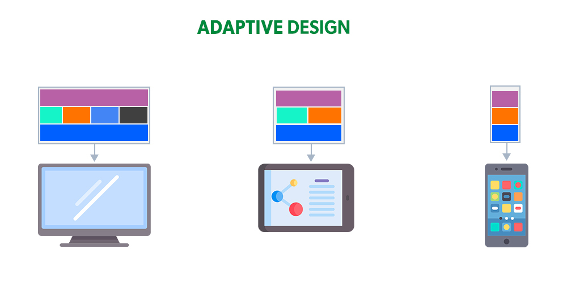
Adaptive Design:

Slide 51
The major difference between these two are:
S. No. | Responsive Design | Adaptive Design
1 | It adjusts its content and width according to the device. | According to the device, it loads the content of the web page that was already designed.
2 | Designers have to work less because they have to create the single layout of the page designers. | Designers have to work more because they have to create six different versions of the site to handle different screen sizes.
3 | If there is any new layout of the screen comes into the market, the content is adjusted according to them. | Designers have to develop a completely new page if the new layout of the screen has come into the market.
4 | Responsive Design works well for larger sites that are being built from the scratch. | Adaptive Design works well for smaller sites that are being refreshed.
5 | Responsive design is smooth because the layout adjusts in the flow regardless of the device being viewed. | Adaptive design snaps into place since the website is serving something different which relies on device or browser used to view it.

Slide 52
The major difference between these two are:
S. No. | Responsive Design | Adaptive Design
6 | Use of Responsive Design It has been made easier for less experienced designers and developers to use Responsive Design with the availability of themes via CMS systems such as WordPress, Joomla, and many more. | Use of Adaptive Design Adaptive is handy for updating an existing site to make it more mobile-friendly.

Slide 53
The major difference between these two are:
S. No. | Responsive Design | Adaptive Design
7 | Pros- Search Engine friendly There are numerous templates to choose from. Flexibility The design process takes a shorter amount of time. Availability of design for all screen resolutions and sizes Widely used Easier implementation | Pros- A company with an adaptive website outperforms on speed tests. Best user experience irrespective to device used. Mobile devices can detect their users’ surroundings. Optimization of advertisements can be carried out through user data from smart gadgets.

Slide 54
The major difference between these two are:
S. No. | Responsive Design | Adaptive Design
8 | Cons- More Coding Advertisements can disappear from the screen The site speed suffers if not implemented properly. Elements can move around Download time is more for mobile devices. | Cons- To begin with, it is normally far more work than building a responsive design. As a result, the bulk of adaptive designs is utilized to modify existing sites so that they may be accessed via numerous devices. Modification in adaptive design websites is complex Not widely used like responsive design
9 | Examples- Slack Dropbox Github Shopify | Examples- Apple Amazon

Slide 55
Reference
https://www.geeksforgeeks.org/web-developer-or-android-developer-which-one-is-better-career-choice/
https://www.linkedin.com/pulse/key-considerations-when-choosing-between-mobile-app-web-david-burkett
https://www.geeksforgeeks.org/advantages-and-disadvantages-of-adaptive-web-design/
https://www.geeksforgeeks.org/difference-between-responsive-design-and-adaptive-design/
https://www.alphadigital.com.au/blog/advice/responsive-adaptive-dedicated-mobile-sites/

Slide 56
THANK YOU
For queries
Email: parveen.e13339@cumail.in

